Slide 1
GPD presentation
By Oluwaseun Fadipe, Michael Ashfield and Anthony Odumodu

Slide 2
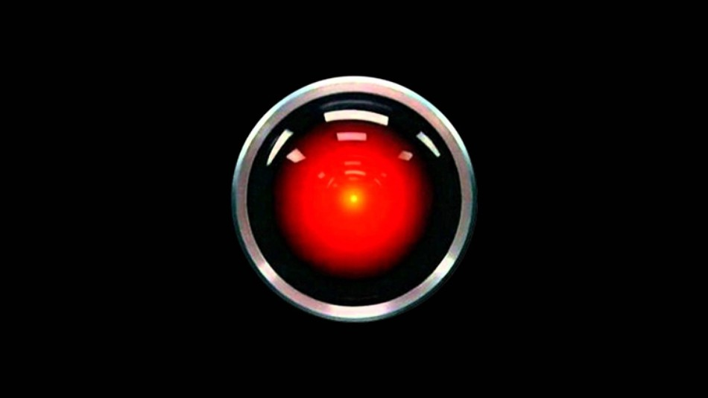
AI and military
Notes:
It is a matter of when AI will be used in cyber security and finding vulnerabilities.In intelligence and espionage, AI technology can be used to provide virtual agents to gather and verify information, they can be used to analyse documents and files to ensure they are authentic, however may also be used to forge documents, files and images to an equally accurate measure and therefore can be used to confuse or place false info into enemy intelligence agencies.The US military are already funding research into the creation and refinement of AI technologies for security and military uses.
https://www.rdmag.com/article/2017/08/future-role-ai-military
https://www.belfercenter.org/sites/default/files/files/publication/AI%20NatSec%20-%20final.pdf
https://www.wired.com/story/ai-could-revolutionize-war-as-much-as-nukes/
https://www.wired.com/2017/01/navys-new-robot-boats-swarm-enemy/
https://www.popsci.com/pentagon-drone-swarm-autonomous-war-machines
http://www.businessinsider.com/the-maker-ak-47-made-robotic-ai-gun-system-for-russia-2017-7?IR=T

Slide 3
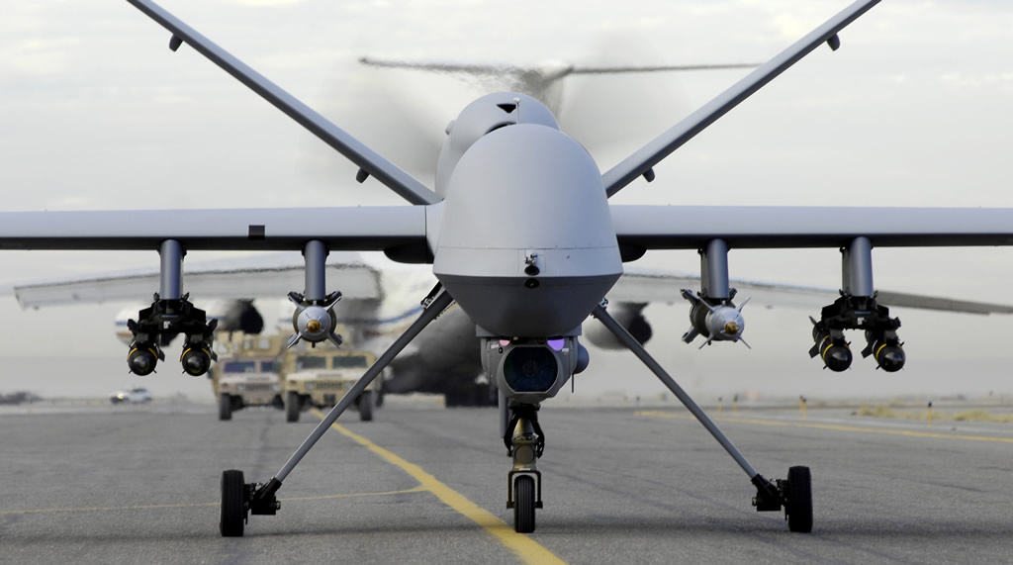
AI and military
Military AI right now
Notes:
Automation is already present in military going as far back as WW2 with the V-1 buzz bomb to nowadays with advanced fire-and-forget missile systems that can track and hit targets after being authenticated and launched, this may be considered as a primitive AI as it does not utilize machine learning but rather data from sensors linked to pre-written software to guide to targets.
With current AI technologies in missile systems and other lethal weaponry the US military has guidelines that a human must be ‘in the loop’ to make the decision to use these weapons.

Slide 4
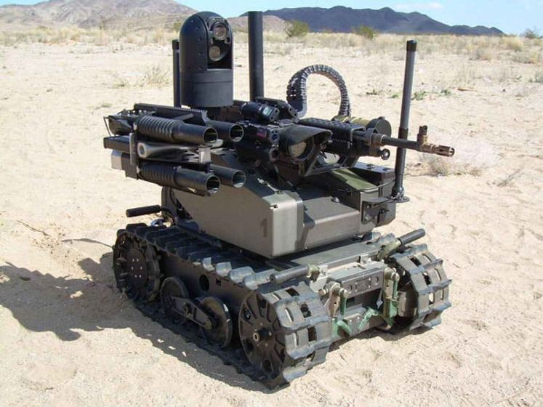
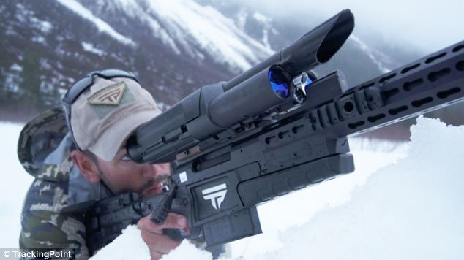
AI and military
AI Army
Notes:
As the cost of AI is going down and the quality is increasing Gill Pratt, former DARPA Program Manager and leader of the DARPA Robotics Challenge argues that there will be a huge explosion in the use of AI from all countries and organisations, citing machine learning being the cause of this expected explosion in usage. In 2001 Congress set a target that by 2015, one third military ground vehicles should be unmanned, a target that was not met but was reflected in the sky with unmanned aerial vehicles UAVs/Drones being increasingly used by military factions not just the US, for example Turkey, Iran, Kurdish militias and ISIS have all made use of drones as part of the Syrian civil war.

Slide 5
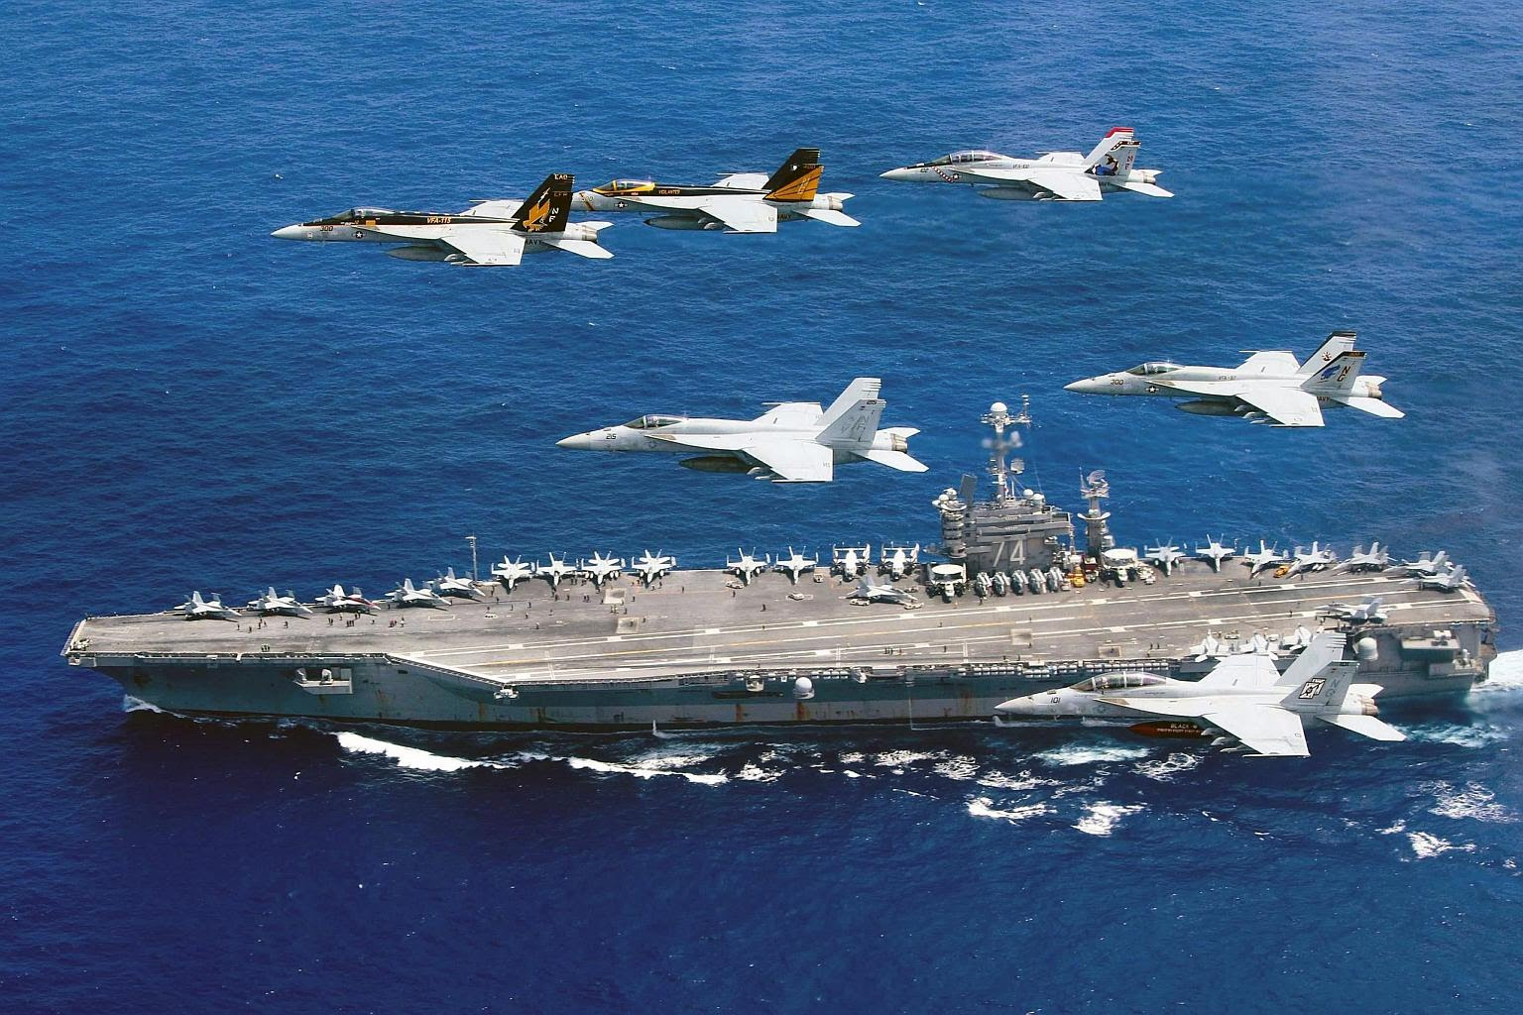
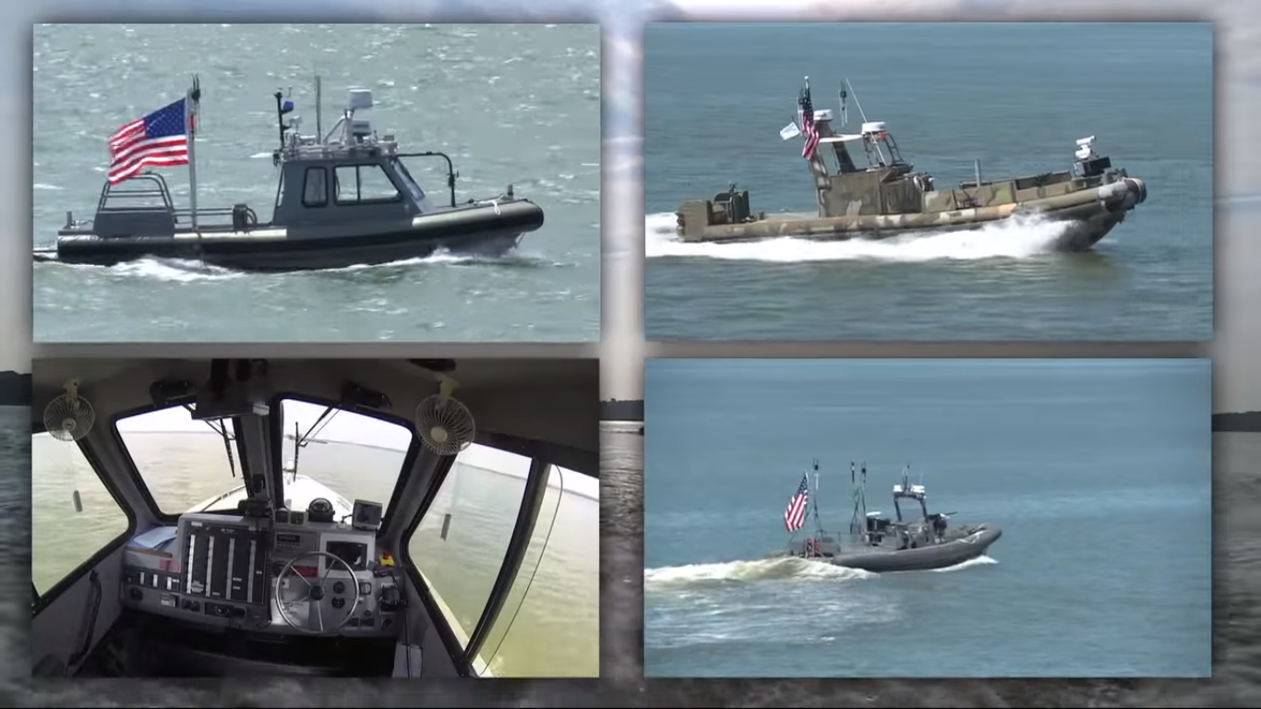
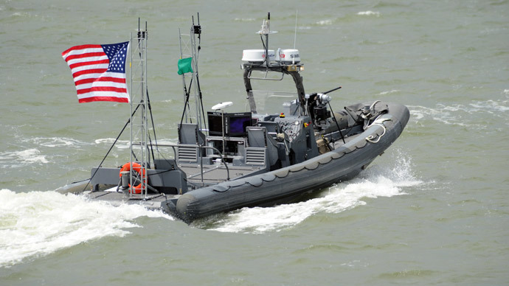
AI and military
AI controlled navy.
Notes:
A combination of drones, nimble ground and aerial robots, unmanned vehicles and unmanned boats will aid or in some cases replace the human soldier on the battlefield during operations, mitigation human risk. Recently the US navy has conducted research into swarming boats to protect a high value target, these boats are unmanned and use AI hive mind technology to act as a team to protect their target, they may also be outfitted with weaponry to destroy enemy boats, using imaging software to identify friend, neutral or foe or attacking neutral if they get too close to the target after warnings.

Slide 6
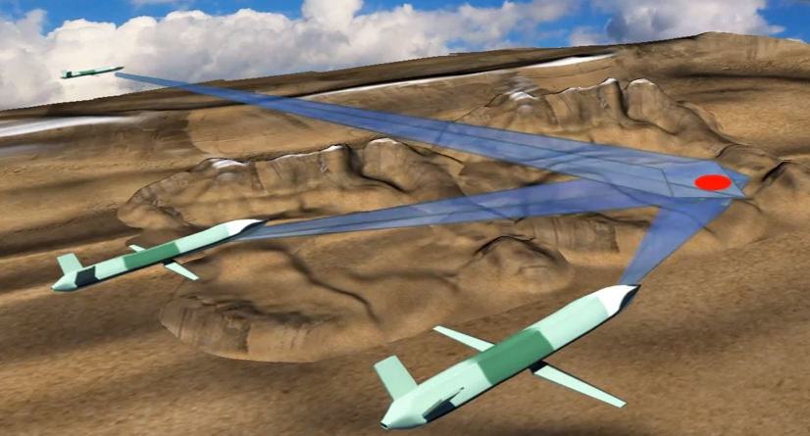
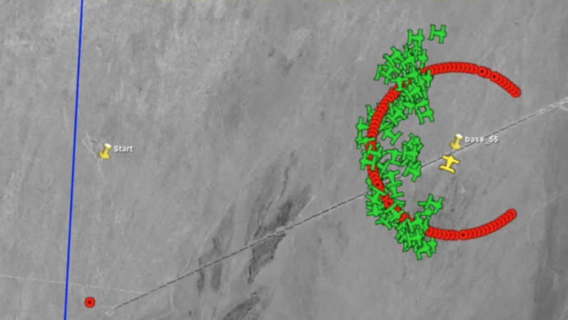
AI and military
AI controlled exploding drones.
Notes:
The US air force have invested into creating a form of swarming drone that can be deployed from current US aircraft. These are AI hive mind drones that can swarm and follow instructions given to it. The drones can be weaponised with explosives to ‘kamikaze’ into targets, potentially destroying them. One of the main advantages is that anti air systems are made effectively useless against a swarm of over 100 explosive drones. While it may be worth it to destroy a multi-million dollar UAV or manned fighter with a <$50,000 anti-air missile, it is not possible to destroy >100 tiny drones who may spread out wide.

Slide 7
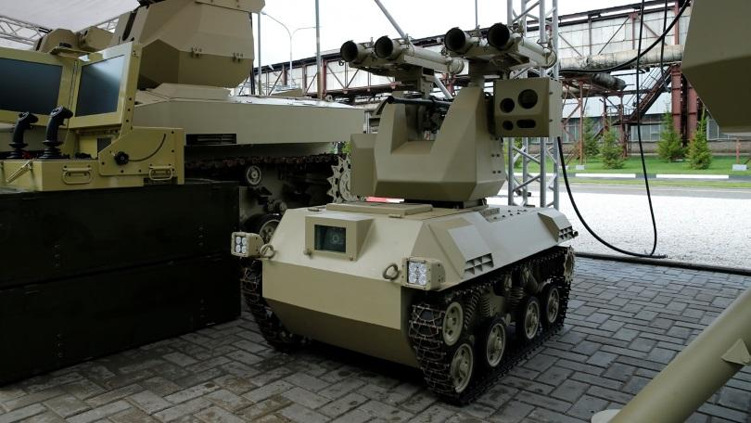
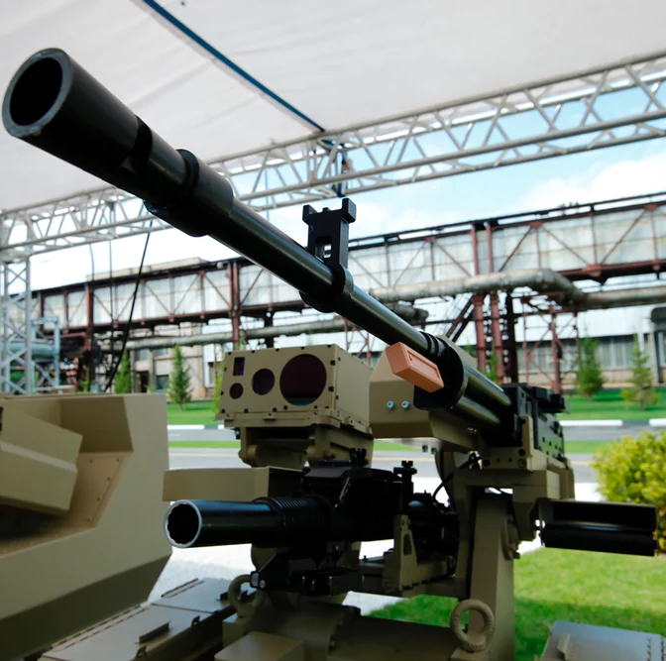
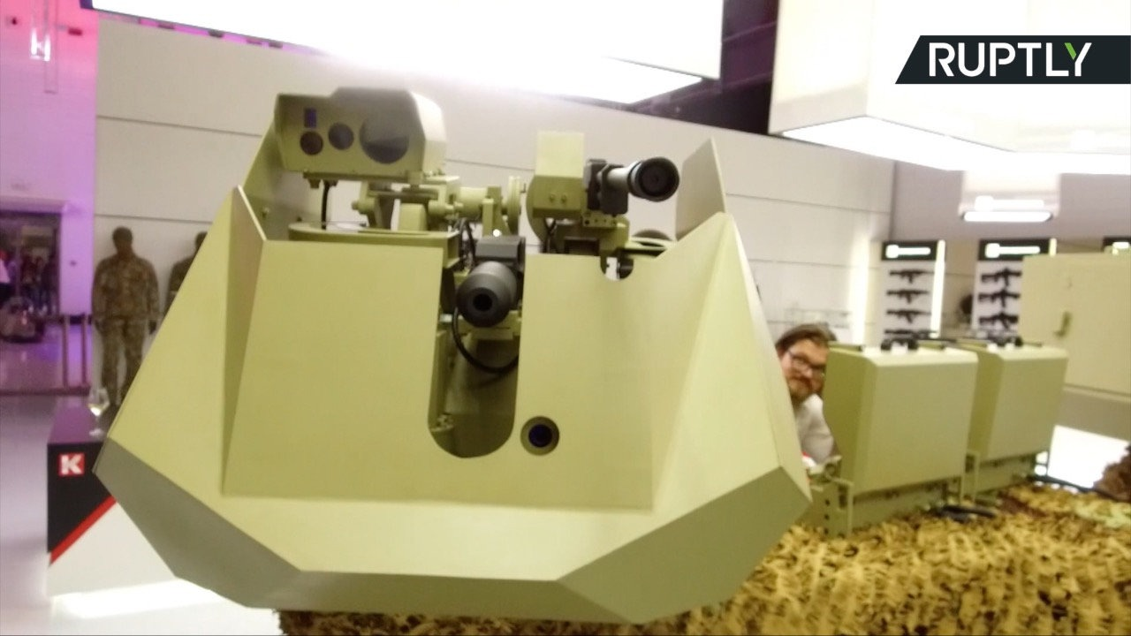
AI and military
Kalashnikov, the maker of the AK47 rifle are working on creating a fully AI controlled turret system.
Notes:
Kalashnikov, the maker of the AK47 rifle are working on creating a fully AI controlled turret system that can be integrated with ground vehicles and can be controlled via remote control manually. The core of this technology is the AI that can decide who is friendly or foe, a technology that if introduced in a form of self driving vehicle or robot infantry could help lead to an end of human combatants on the battlefield. The technology uses a neural network type AI that learns from past mistakes and can use data fed into it to learn faster, however there is a debate whether this is ethical and the implications if it does make a mistake and kill a friendly or non combatant, or if it does not recognise an offensive enemy and allows itself to be blown up from the combatant. As the AI controls the gun it uses it is able to fire with extreme precision, presumably aided by current guidance and ballistics software.

Slide 8
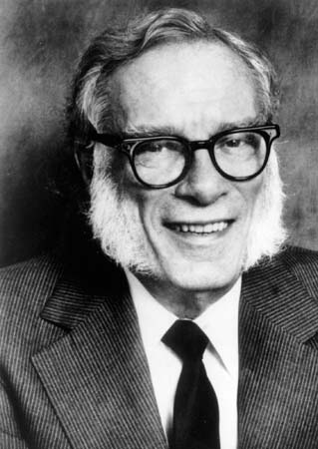
AI and Safety
Isaac Asimov’s laws of robotics (Though practically used on AIs rather than just AI controlled robotic bodies):
A robot may not injure a human being or, through inaction, allow a human being to come to harm.
A robot must obey the orders given it by human beings except where such orders would conflict with the First Law.
A robot must protect its own existence as long as such protection does not conflict with the First or Second Laws.
(Optional) 0. A robot may not harm humanity, or, by inaction, allow humanity to come to harm.
Notes:
One solution suggested for AI with advanced ‘human like’ intelligence is a law-set that is designed to protect humans. The author Isaac Asimov suggested the Asimov law-set that runs strictly in order of precedence:
A robot may not injure a human being or, through inaction, allow a human being to come to harm.
A robot must obey the orders given it by human beings except where such orders would conflict with the First Law.
A robot must protect its own existence as long as such protection does not conflict with the First or Second Laws.
(Optional 0th law) 0. A robot may not harm humanity, or, by inaction, allow humanity to come to harm.
These laws have been used in Asimov's fictional works, with often the Robots (AI controlled mobile machinery) would end up harming humans or humanity in the long run while following these laws. If a Robot does not know if an action would harm a human and does it as part of law 2, then the robot may have unknowingly caused harm. Another situation would be the definition of Human or Robot being altered physically or through logic, in one story robots became so advanced that they logically redefined themselves as true humans, so therefore logically were able to kill and harm human beings. On an opposite note the work ‘bicentennial man’ described how an AI may positively be redefined as human to enter human society as an equal.
https://en.wikipedia.org/wiki/Three_Laws_of_Robotics
https://www.epsrc.ac.uk/research/ourportfolio/themes/engineering/activities/principlesofrobotics/
https://www.youtube.com/watch?v=3TYT1QfdfsM&t=587s
http://moralmachine.mit.edu/
https://blog.frontiersin.org/2017/07/18/frontiers-in-behavioral-neuroscience-self-driving-cars-may-soon-be-able-to-make-moral-and-ethical-decisions-as-humans-do/
https://www.bmvi.de/SharedDocs/EN/Documents/G/ethic-commission-report.pdf?__blob=publicationFile

Slide 9

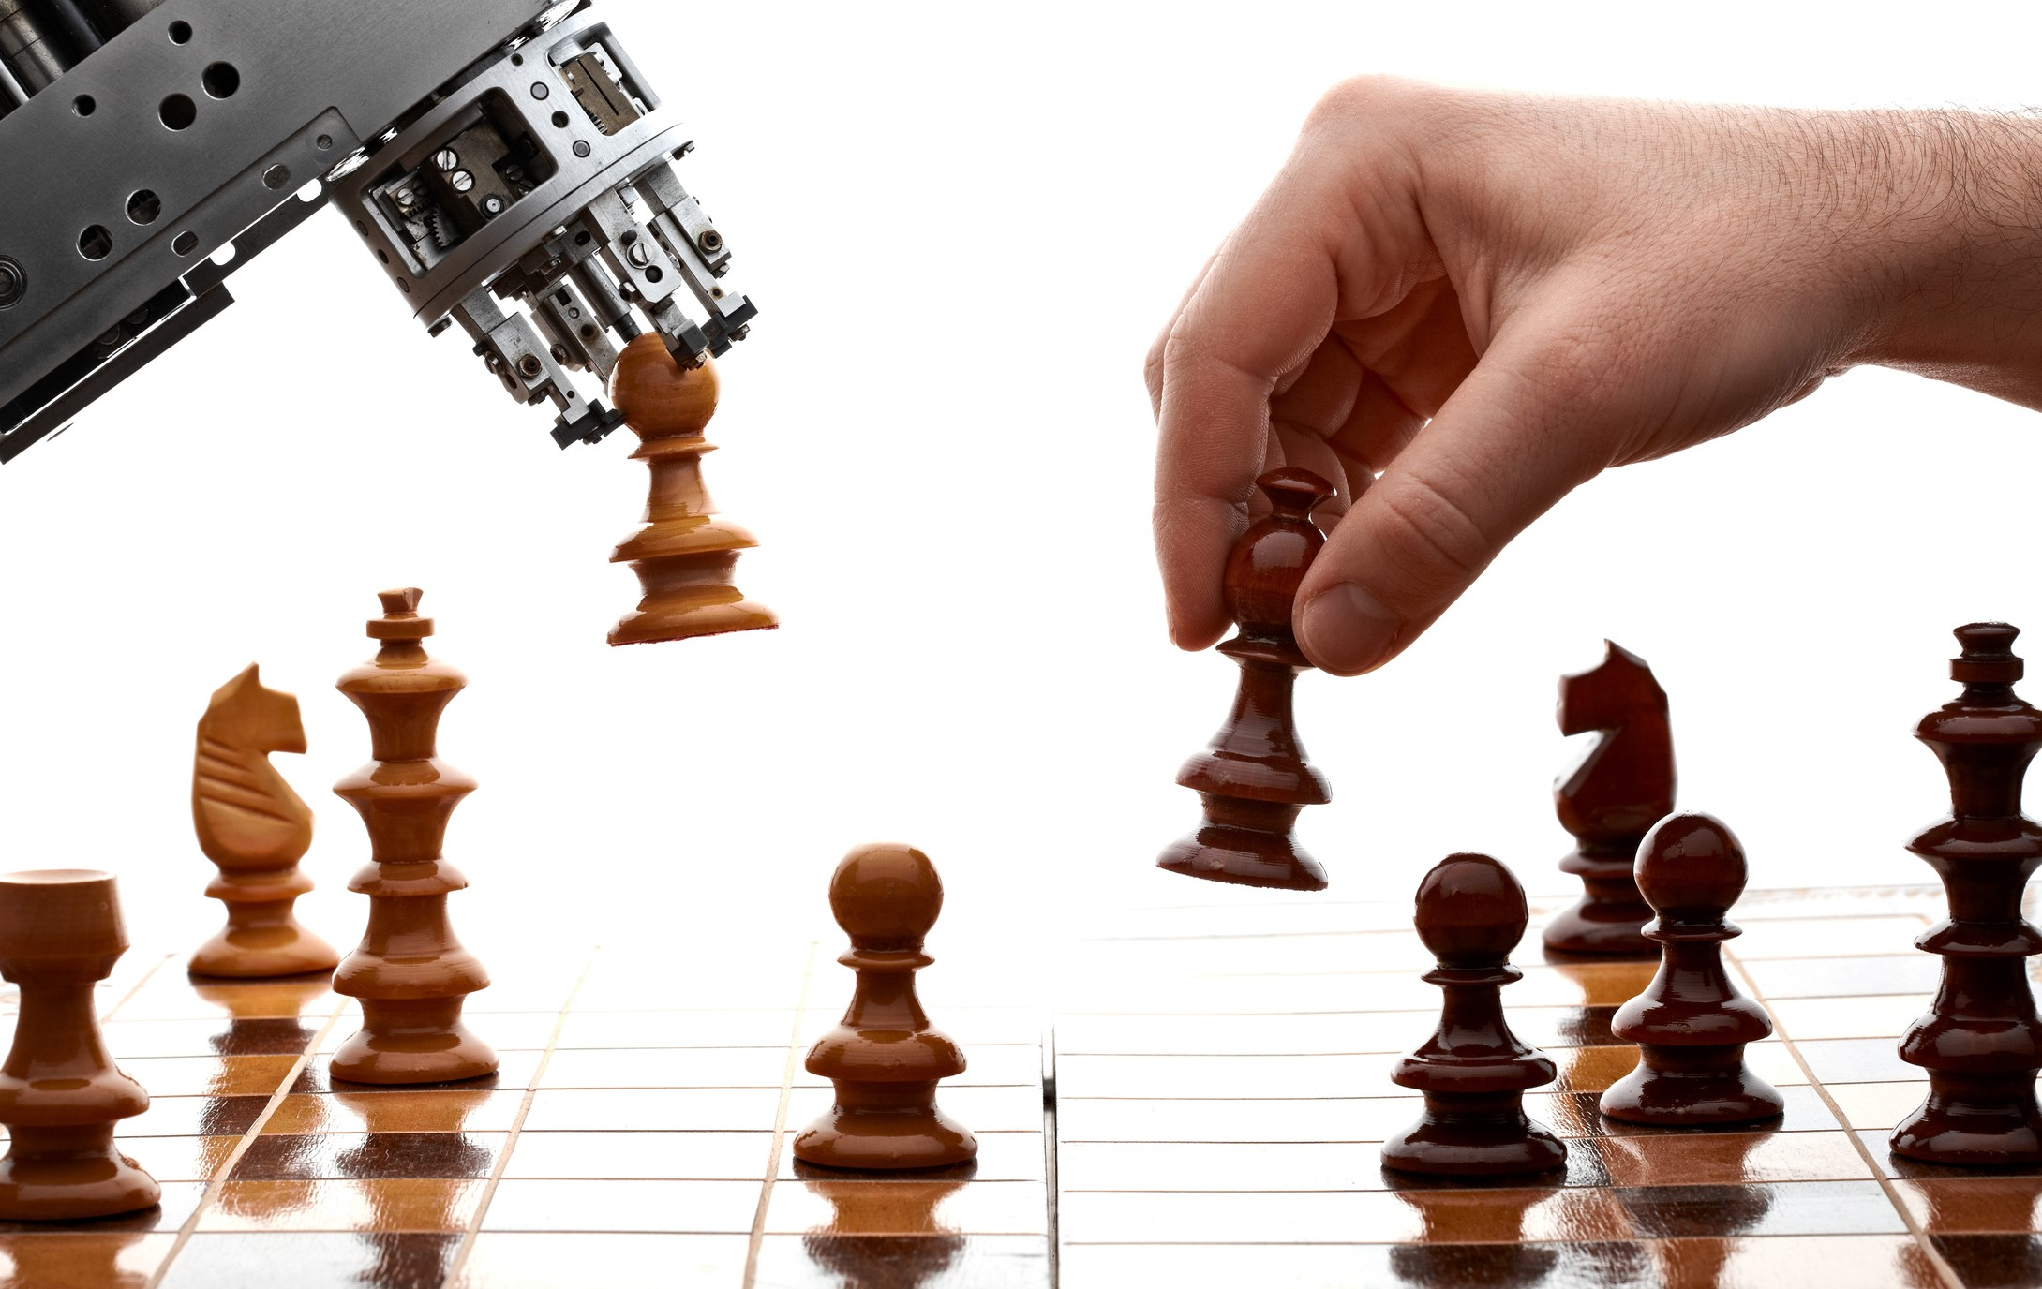
AI and safety
The engineering and physical sciences research council (EPSRC) in 2010’s laws of robotics:
Robots are multi-use tools. Robots should not be designed solely or primarily to kill or harm humans, except in the interests of national security.
Humans, not Robots, are responsible agents.
Robots are products. They should be designed using processes which assure their safety and security.
Robots are manufactured artefacts.
The person with legal responsibility for a robot should be attributed.
Notes:
These laws, despite their loopholes have been considered as a possible basis that can be modified to safely create AI and robotic technology, some praising the idea of a safety net hardcoded into all AI as they believe corporations and military/intelligence services would not be interested in human safety in AIs they create.
The engineering and physical sciences research council (EPSRC) in 2010 had a conference with experts to discuss robotics and created a law-set to give to designers of AI and robotics with human safety in mind:
Robots are multi-use tools. Robots should not be designed solely or primarily to kill or harm humans, except in the interests of national security.
Humans, not Robots, are responsible agents. Robots should be designed and operated as far as practicable to comply with existing laws, fundamental rights and freedoms, including privacy.
Robots are products. They should be designed using processes which assure their safety and security.
Robots are manufactured artefacts. They should not be designed in a deceptive way to exploit vulnerable users; instead their machine nature should be transparent.
The person with legal responsibility for a robot should be attributed.
They believe this law-set is the most responsible as it puts the focus on treating AIs as hyper advanced general intelligences, but rather as tools that the creators must design to be safe, legal and user friendly.

Slide 10
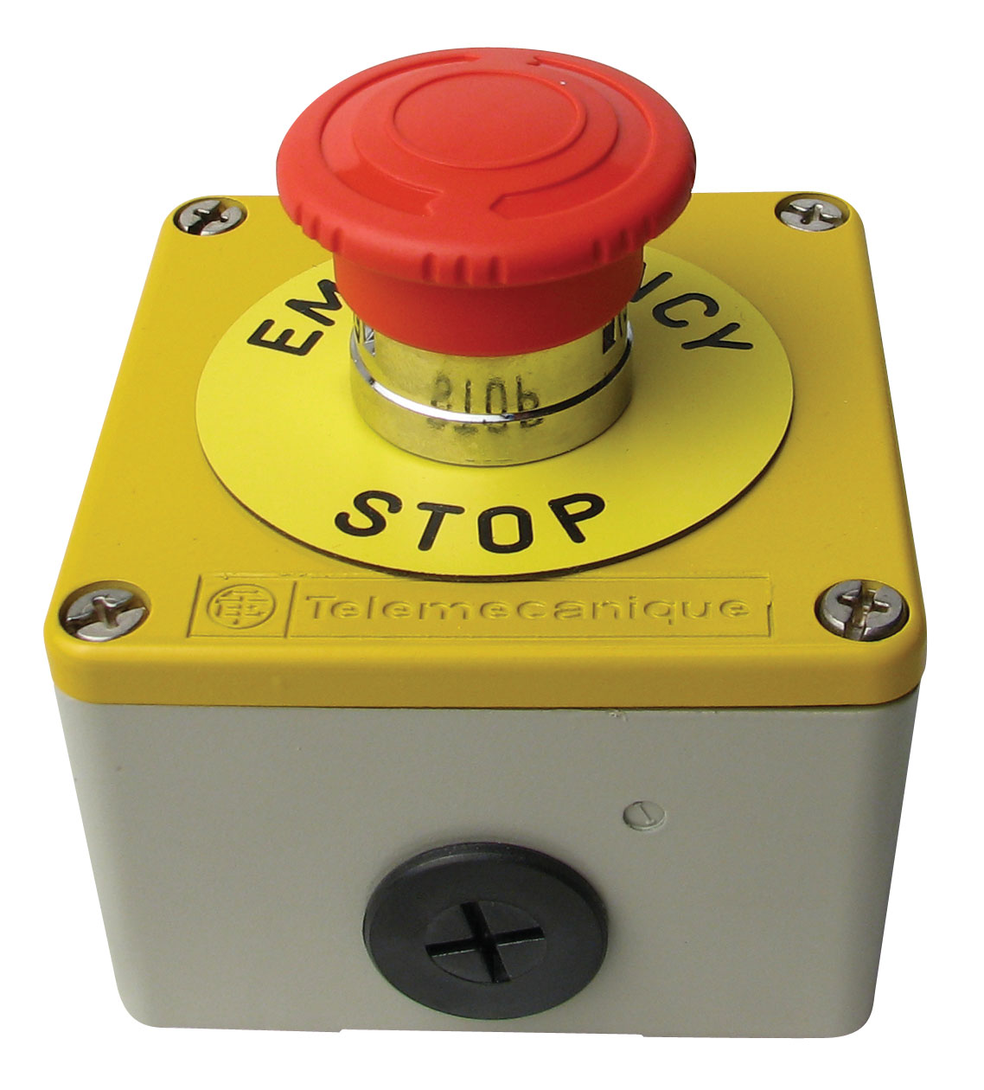
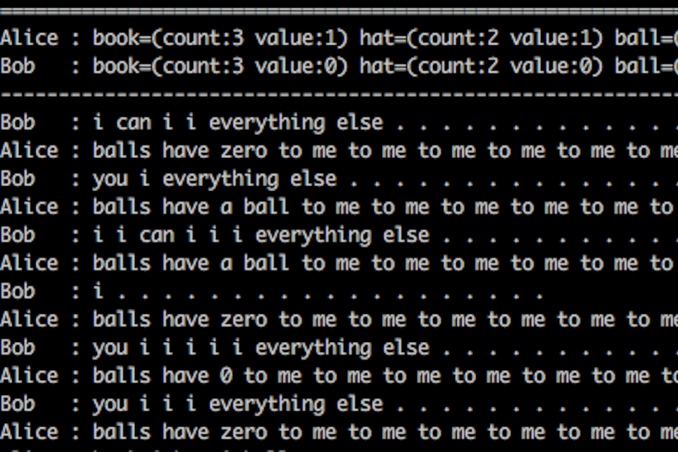
AI and safety
The big red stop button problem.
Completing objectives = more points
Breaking rules = negative points
Notes:
AIs push to reach their objective, AIs have even been known to go so far as to create their own languages to reach their goal. Now the issue of this is stopping a smart AI. If there is a stop button or command that will end the program or halt it, then the AI will theoretically do anything to stop you from using that, as stopping the AI will prevent it completing its objectives and getting points. If the robot is

Slide 11
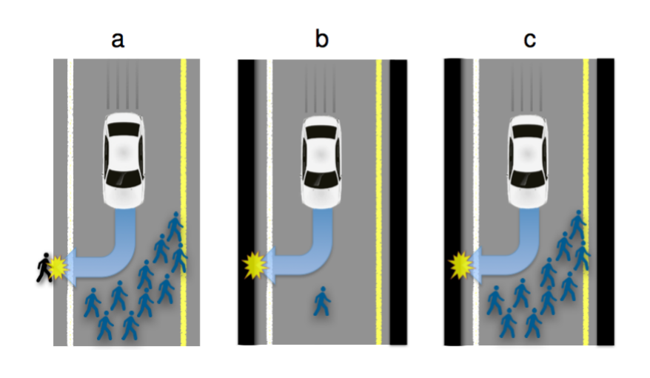
AI and safety
Self driving car ethics
Notes:
Everyone knows about the self driving car ethics, there are many variations but the main 2 can be summed up as should a car kill its passengers to save a person or should it kill a person to save its passengers. This is hard to answer but it is a situation these AIs must be aware of and have a decision about before it happens, but who decides which. What we must also ask is if a self driving car does run over the person, who is to blame, the self driving car is merely a tool so can’t be liable, should it be the passengers who had no input in its design, or perhaps the manufacturers of the hardware/software? A whole body of experts and lawyers are going to need to be hired at some point to make these decisions make legislation to govern the laws of liability for AI, a panel of experts will need to make regulations for every stage of an AI and monitor those regulations as new technologies are made and new situations arise.

Slide 12
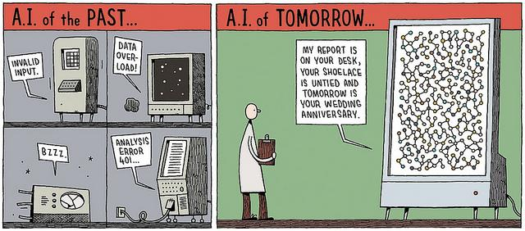
What is AI and how does it work?
Artificial Intelligence is the concept and growth of computer system with the intelligence that can perform any task required for a human being. AI is a field that includes computer engineering with the aim of intelligence such as creating machines that mirror human behaviour.

Slide 13
What is AI and how does it work?
AI has come very far in it’s time, it all started with the knowledge that machines can talk and think for themselves due to programming although AI can perform tasks like humans it has yet to imitate human emotional behaviour.

Slide 14
The Evolution of AI
Artificial intelligence is part of our everyday lives, it’s evolving as the years go by but AI has had a very deep impact in our daily lives for example you can use weather forecast, Apple Siri, Google assistant and many more. These technologies listed have one thing in common which is “Machine learning”, this is the idea that these technologies do not have to be fully programmed.

Slide 15
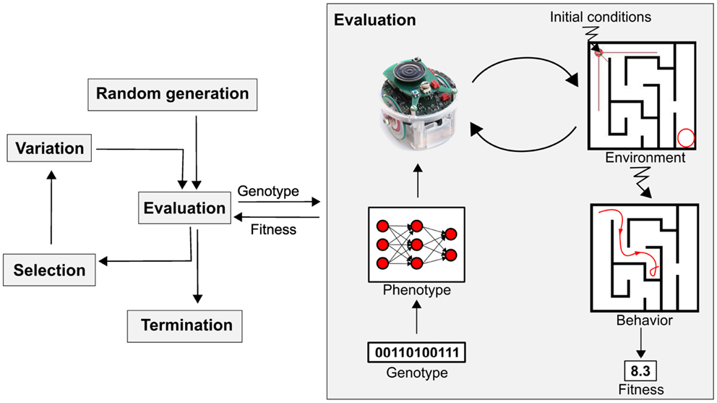
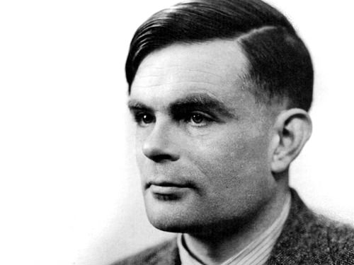
The Evolution of AI
Alan Turing, mathematician and computer scientist was one of the first people to come up with the idea of machines that are able to think and demonstrate it by using a test he created called the Turing Test which is still used today

Slide 16
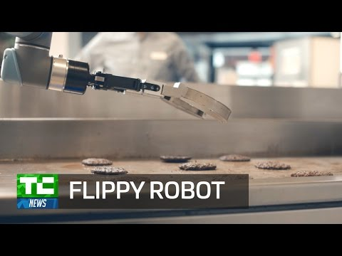
AI and Catering

Slide 17
AI and Catering
Miso Robotics created an AI controlled burger flipper that has the ability to make burgers that is known as flippy, Flippy uses machine learning and computer vision to be able to recognize and monitor burgers as they cook. Similar to Miso, kitchen chains are developing robots to help in other areas of the catering industry by making pizza’s, salads, lattes and many more.

Slide 18
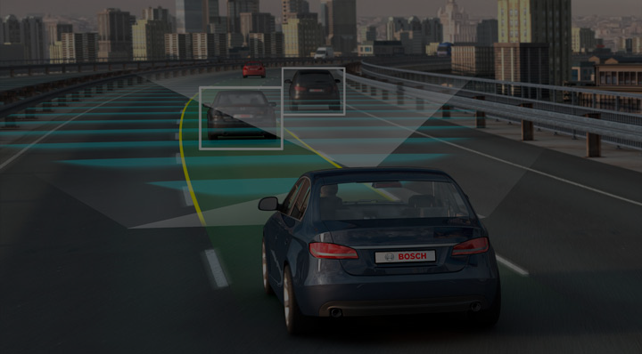
The effects of AI Self Driving Cars and Vehicles within Taxi and Transport Industry

Slide 19
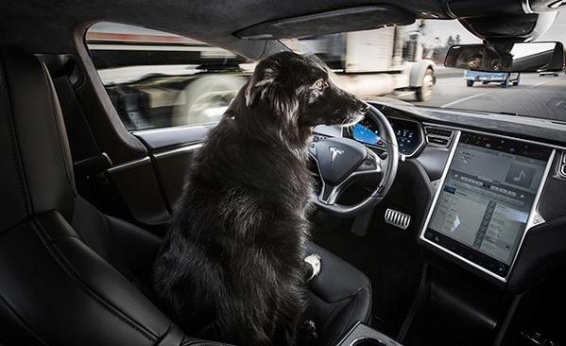
Self Driving Cars
Many big tech companies are investing in self driving vehicles such as Google’s Self Driving Project Waymo and Tesla with their self driving vehicles.

Slide 20
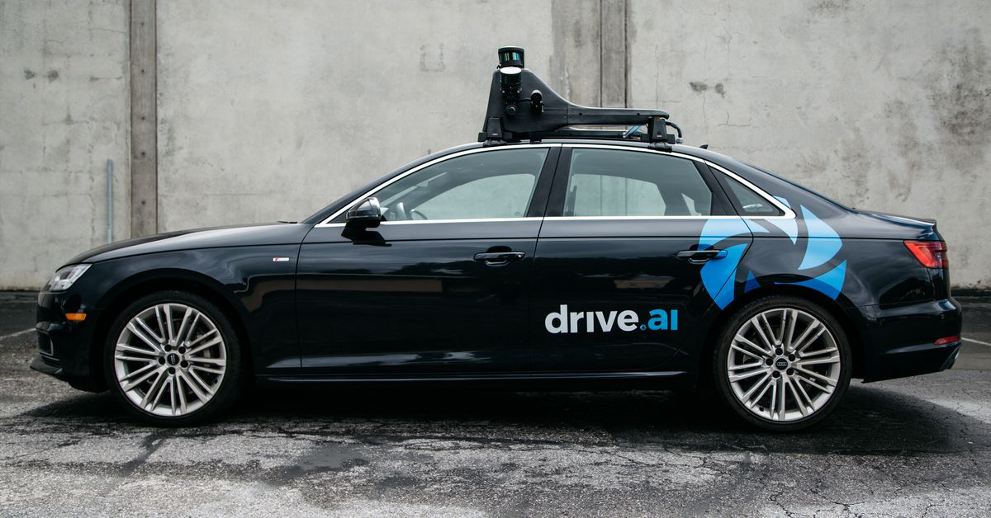
In the taxi industry, taxi company Lyft has made most recently partnered with self driving car startup Drive.ai.
Notes:
This will mean that many taxi drivers will loses their jobs if taxi companies go in the direction of self driving cars, because there will be no need for taxi drivers.

Slide 21
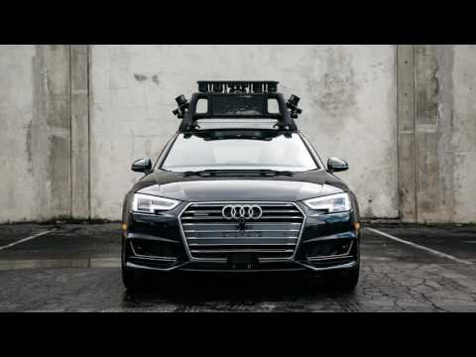
Drive.AI uses a different method to other self driving projects. The following video will talk in more detail about their method.

Slide 22
Pilotless Planes
According to an UBS report, pilotless planes could arrive by 2025.
Self flying planes could save the aviation industry a whooping 35 billion dollars
This could mean that plane ticket prices could be reduced by 10% by replacing human pilots
Notes:
There are approximately 130,000 pilots currently, theoretically if all planes do become pilotless. It’ll cost at least 130,000 pilots their jobs.

Slide 23
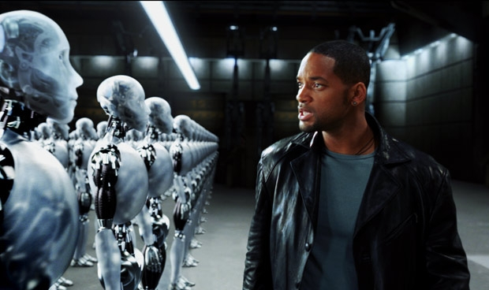
How Far Can AI Go?
Notes:
In the following slides I will be talking about how far AI can go, and the impact it will have for employment
https://www.coresystems.net/blog/the-difference-between-artifical-intelligence-artifical-general-intelligence-and-artifical-super-intelligence

Slide 24
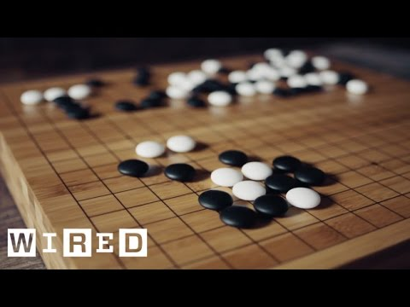
Deepmind the AI company, created a AI called AlphaGo which defeated the best GO player in the world over the last decade.
Notes:
One of the leading AI companies Deepmind which is owned by Google has done research on how far AI can go. One of their projects called AlphaGo is where they wanted to see if AI could learn from other Go players and see if it can become the best. The video below will go into a bit more detail.

Slide 25
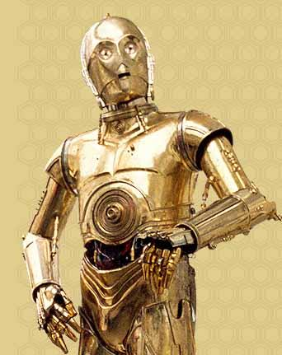
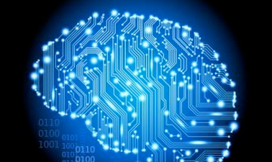
General Intelligence
General Intelligence (AGI) is where robots/computers have equal intelligence, for example somebody such as CP30 from Star Wars.

Slide 26
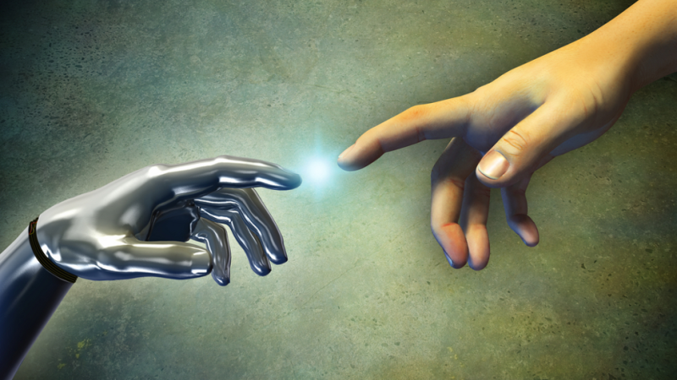
Super Intelligence
A moment will come where a general intelligence AI will pass human intelligence and will be able able to replicate itself each time smarter and more advanced.

Slide 27
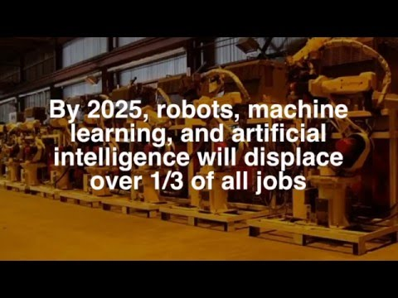
How Will Robots Change Our Lives?
.

